Slide 1

Mini project cz1003
Guo Wei
Zheng yang
Cyrus

Slide 2
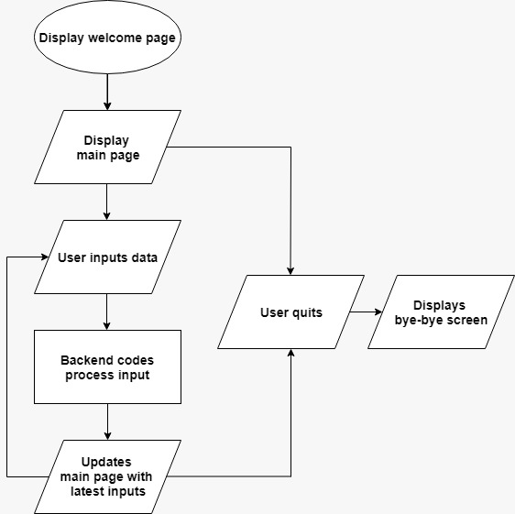
flowchart

Slide 3
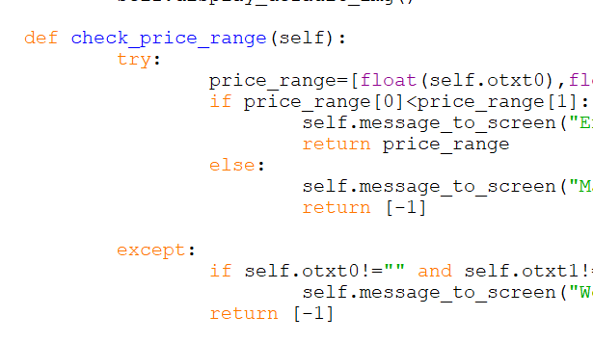
Input price
Exception handling

Slide 4
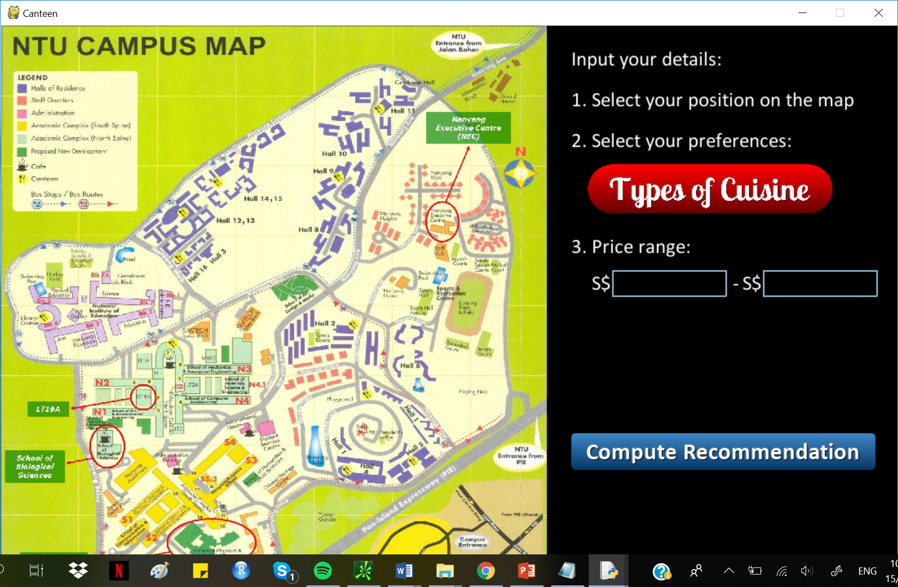
Display pages
Separate python file
Create class
File management
Decomposition

Slide 5
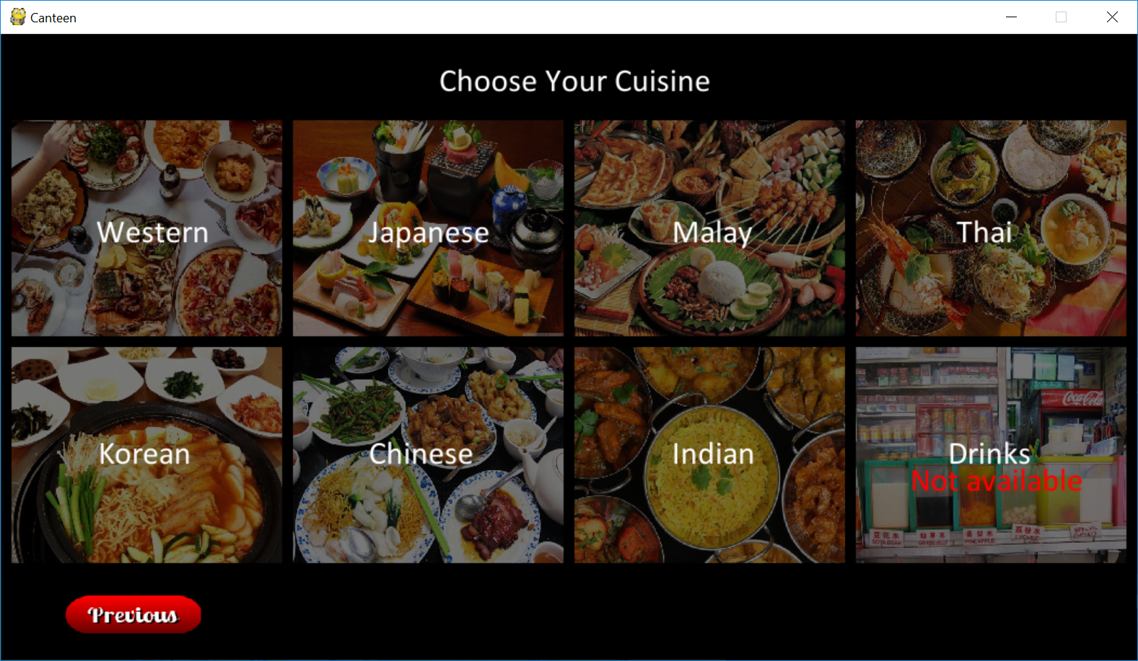
Choosing cuisine
Display standard boxes that can be reused by changing stage no.
Mouseclick record coordinates. If match with box area, stage will change.

Slide 6
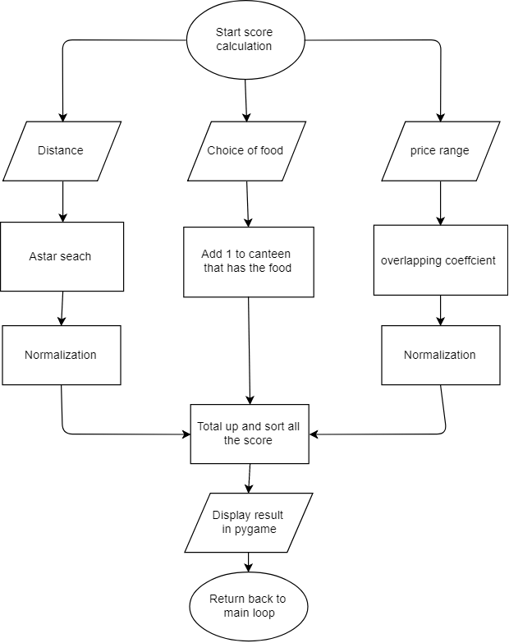

Slide 7
SEARCH CANTEENS – a*

Slide 8
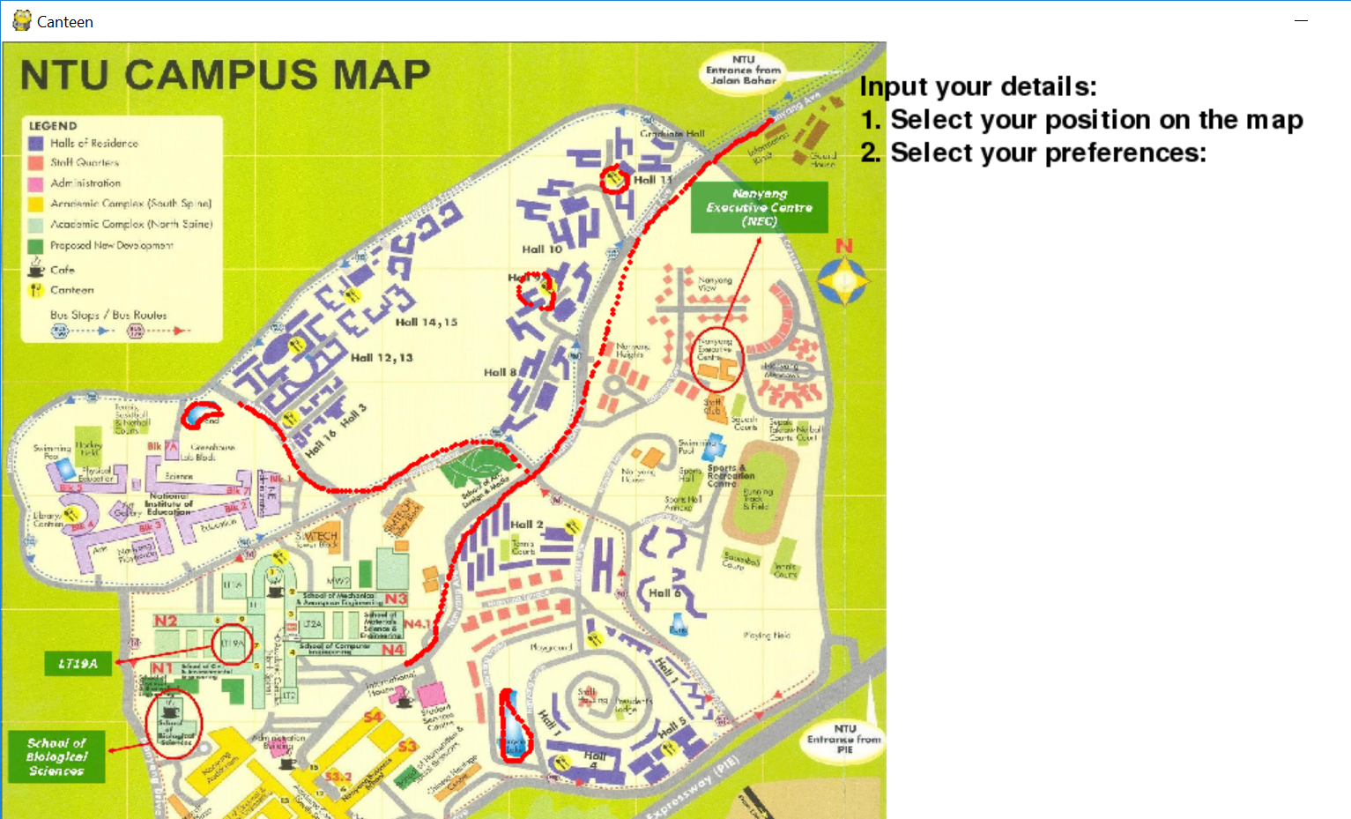
Data collection
MAP: Traced out coordinates of bus routes, no-go areas (e.g. water bodies), canteen locations
CANTEENS: What types of stalls

Slide 9
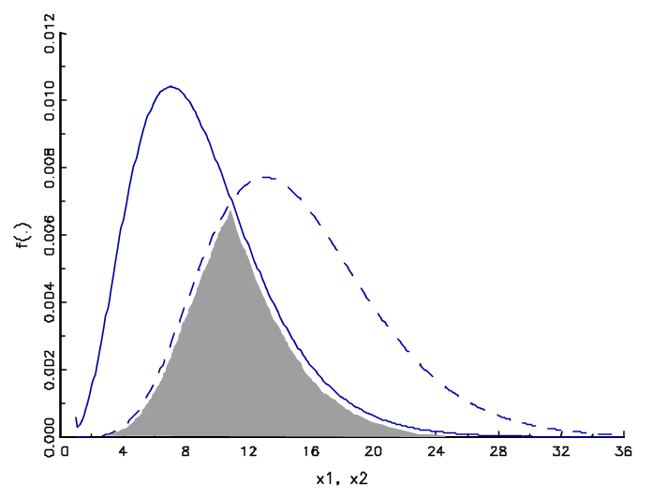
Overlapping coefficient

Slide 10
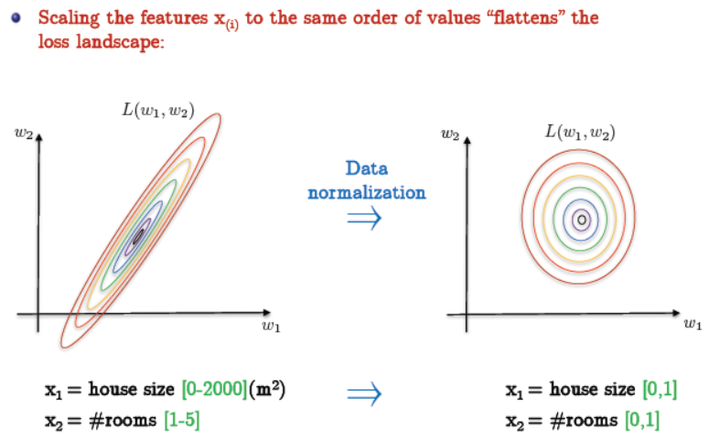
Normalization
From, CE9010: Introduction to Data science

Slide 11
Score up
Using Algo.py
Compute scores based on the 3 variables:
User location 2. Budget 3. Cuisine

Slide 12
Q & A

